Slide 1
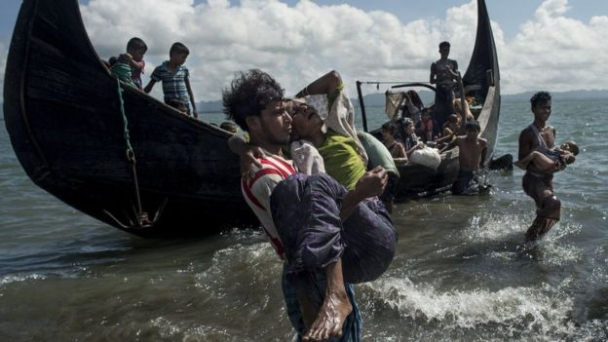
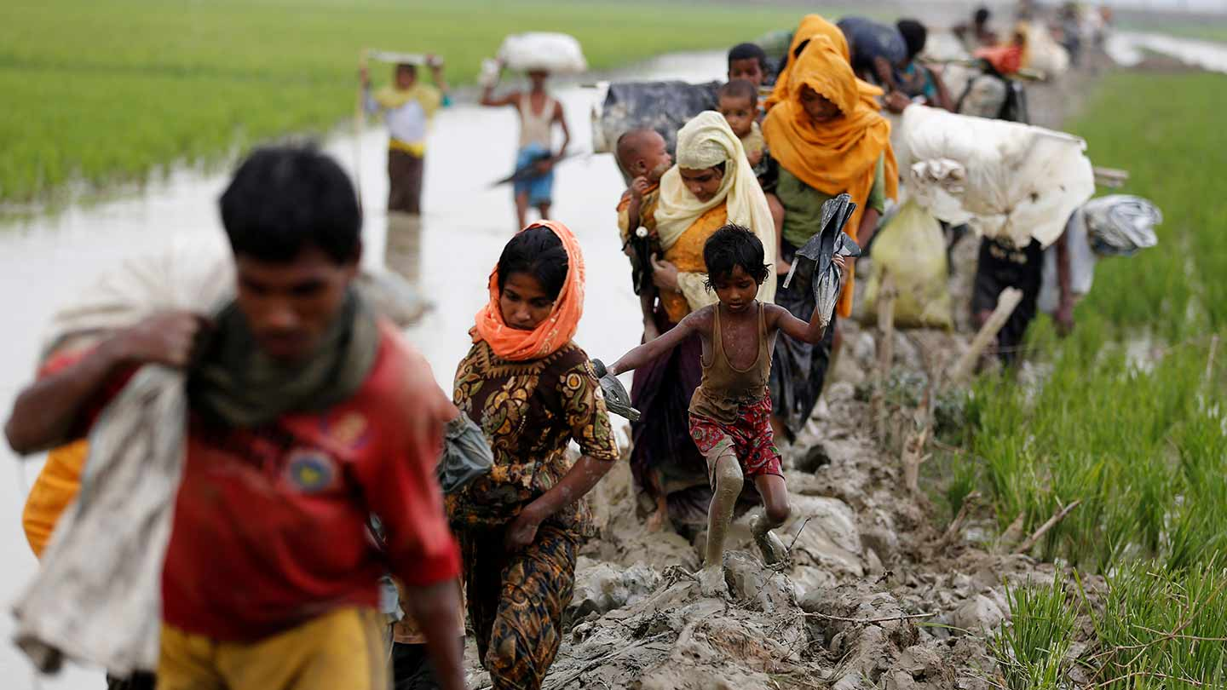
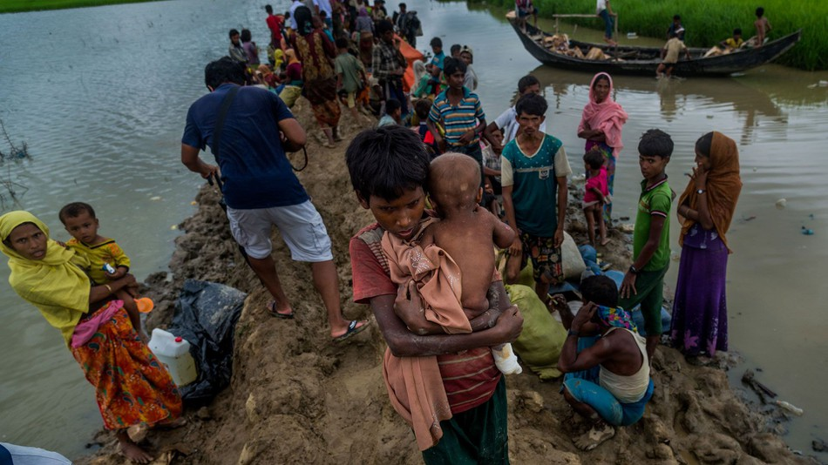
Pray for the Rohingya Refugees
Your ongoing generous support and prayers are much needed and welcomed.

